Slide 1


Note: The data and information in this document is reflective of a hypothetical situation and client. This document is to be used for KPMG Virtual Internship purposes only.
Data Analytics, Information & Modelling Team
Data analytics approach
Buddaraju Naveen Kumar Raju

Slide 2
Note: The data and information in this document is reflective of a hypothetical situation and client. This document is to be used for KPMG Virtual Internship purposes only.
Agenda
Introduction
Data Exploration
Model Development
Interpretation

Slide 3
Note: The data and information in this document is reflective of a hypothetical situation and client. This document is to be used for KPMG Virtual Internship purposes only.
Introduction
Analyzing the existing customer dataset to target 1000 new customers to drive the value of Sprocket Central Pty Ltd
Outline of Problem
Sprocket central is a company that specializes in high-quality bikes and cycling accessories.
Their marketing team is looking to boost business sales by analyzing provided datasets.
Using the 3 datasets provided the aim to analyze and recommend 1000 customers that Sprocket Central should target to drive higher value for the company
Contents of Data Analysis
‘New’ and ‘old’ Customer Age Distributions.
Bike related purchases over the last 3 years by gender.
Job industry distributions
Wealth segmentation by age category
Number of cars owned and not owned by state
RFM Analysis and customer classification

Slide 4
Note: The data and information in this document is reflective of a hypothetical situation and client. This document is to be used for KPMG Virtual Internship purposes only.
Data Exploration
Data Quality Assessment and ‘Clean up’
Key Issues for Data Quality Assessment
Accuracy : Correct Values
Completeness : Data Fields with Values
Consistency : Values Free from Contradiction
Currency : Values up to date
Relevancy : Data Items with Value Meta-data
Validity : Data containing Allowable Values
Uniqueness : Records that are Duplicated

Slide 5
Note: The data and information in this document is reflective of a hypothetical situation and client. This document is to be used for KPMG Virtual Internship purposes only.
Data Exploration
Data Quality Assessment and ‘Clean up’
Summary Table
 | Accuracy | Completeness | Consistency | Currency | Relevancy | Validity
Customer Demographic | DOB: Inaccurate Age: Missing | Job title: Blanks Customer ID: Incomplete | Gender: Inconsistency | Deceased customers: Filter out | Default column: Delete
Customer Address |  | Customer ID: Incomplete | States: Inconsistency
Transactions | Profit: Missing | Customer ID: Incomplete Online order: Blanks Brand: Blanks |  |  | Cancelled Status order: Filter out | List price: Format Products sold date: Format

Slide 6
Note: The data and information in this document is reflective of a hypothetical situation and client. This document is to be used for KPMG Virtual Internship purposes only.
Data Exploration
‘New’ and ‘Old’ Customer Age Distributions
Most customers are aged between 40-49 in ‘New’. In ‘Old’ majority of customers are aged between 40-49 also.
The lowest age group are under 20 and 80+ for both ‘New’ and ‘Old’ customer lists.
The ‘New’ customer list suggests that age group 20-29 and 40-69 are most populated.
The ‘Old’ customer list suggests 20-69.
There is a steep drop of customers in the 30-39 age group in ‘New’

Slide 7
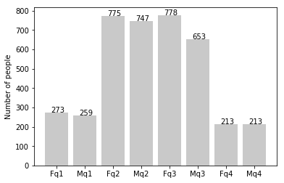
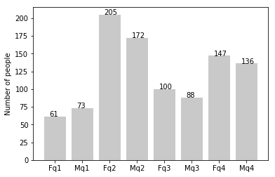
Note: The data and information in this document is reflective of a hypothetical situation and client. This document is to be used for KPMG Virtual Internship purposes only.
Data Exploration
‘New’ and ‘Old’ Customer Age Distributions

Slide 8
Note: The data and information in this document is reflective of a hypothetical situation and client. This document is to be used for KPMG Virtual Internship purposes only.
Data Exploration
Bike related purchases over last 3 years by gender
Over the last three years about 50% of bike related purchases were made by females to 48% of purchases made by males. Approximately 2% were made by unknown gender.
Numerically, females purchased almost 10,000 bikes more than males.
Females make up majority of bike related sales

Slide 9
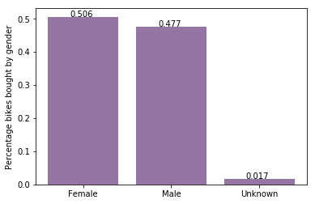
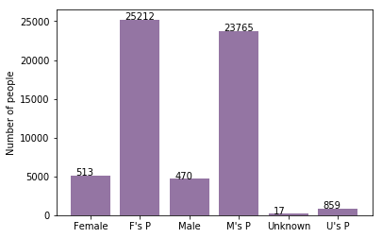
Note: The data and information in this document is reflective of a hypothetical situation and client. This document is to be used for KPMG Virtual Internship purposes only.
Data Exploration
‘New’ and ‘Old’ Customer Age Distributions

Slide 10
Note: The data and information in this document is reflective of a hypothetical situation and client. This document is to be used for KPMG Virtual Internship purposes only.
Data Exploration
Wealth Segmentation by age category
In all age categories the largest number of customers are classified as ‘Mass customer’.
The next category is the ‘High Net Worth’ customers.
The ‘Affluent Customer’ can outperform the ‘High Net Worth’ customer in the 40-49 age group.

Slide 11
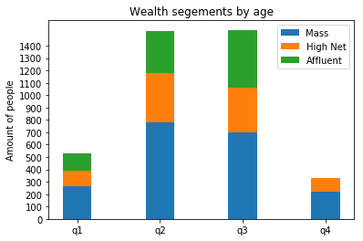
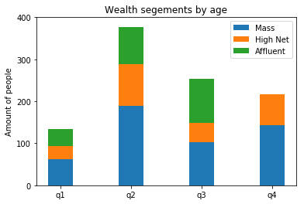
Note: The data and information in this document is reflective of a hypothetical situation and client. This document is to be used for KPMG Virtual Internship purposes only.
Data Exploration
‘New’ and ‘Old’ Customer Age Distributions

Slide 12
Note: The data and information in this document is reflective of a hypothetical situation and client. This document is to be used for KPMG Virtual Internship purposes only.
Model Development
RFM Analysis and Customer Classification
RFM Analysis is used to determine which customer a business should target to increase it’s revenue and value.
The RFM( Recency, Frequency, and Monetary) model shows customers that have displayed high levels of engagement with the business in the three categories mentioned

Slide 13
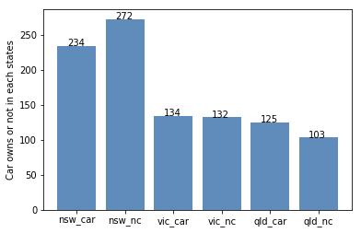
RFM Analysis and Customer Classification

Slide 14
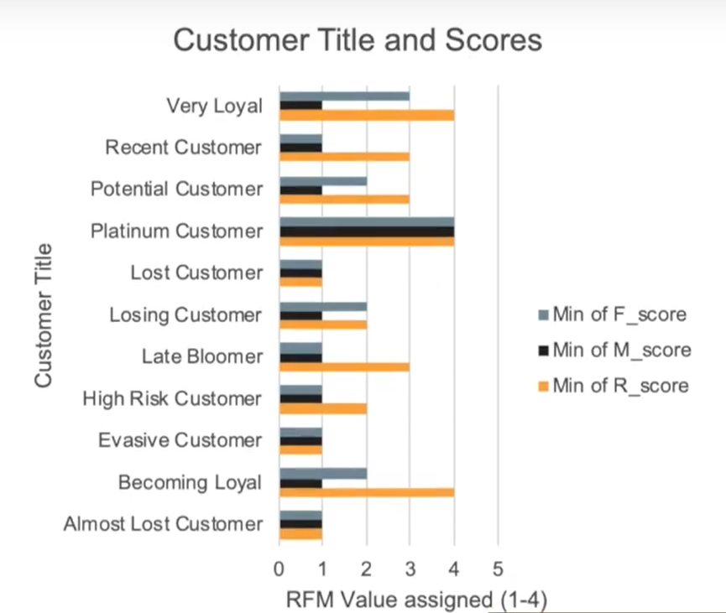
Note: The data and information in this document is reflective of a hypothetical situation and client. This document is to be used for KPMG Virtual Internship purposes only.
Model Development
Scatter-Plot based off RFM Analysis
The chart shows that customers who purchased more recently have generated more revenue, than customers who visited a while ago.
Customers from recent past (50-100 days) also show to generate a moderate amount of revenue.
Those who visited more than 200 days ago generate low revenue

Slide 15
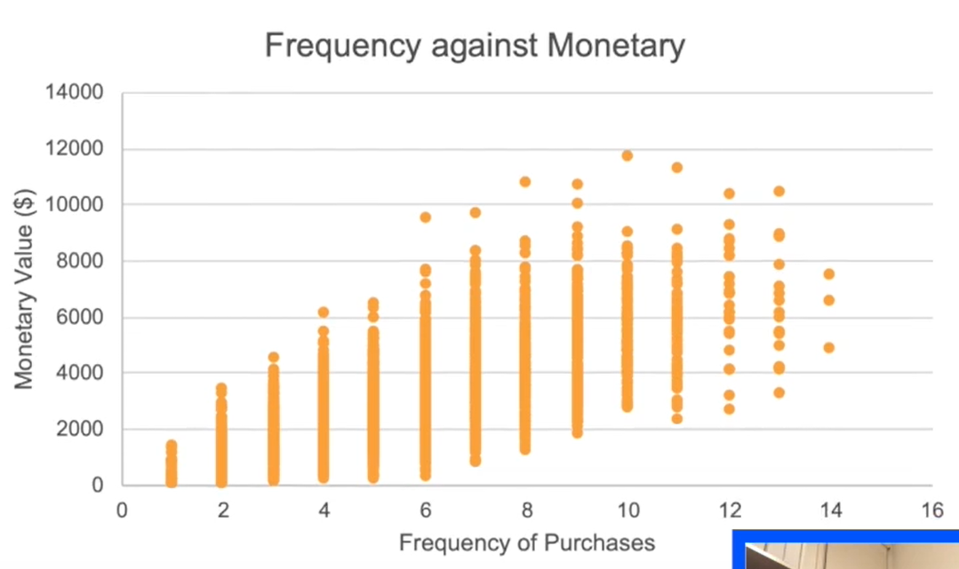
Note: The data and information in this document is reflective of a hypothetical situation and client. This document is to be used for KPMG Virtual Internship purposes only.
Model Development
Scatter-Plot based off RFM Analysis
Customer classified as “Platinum Customer”. “Very loyal” and “Becoming loyal” visit frequently, which correlated with increased revenue for the business.
Naturally, there is a positive relationship between frequently and monetary gain for the business.
Place any supporting images, graphs, data or extra text here.

Slide 16
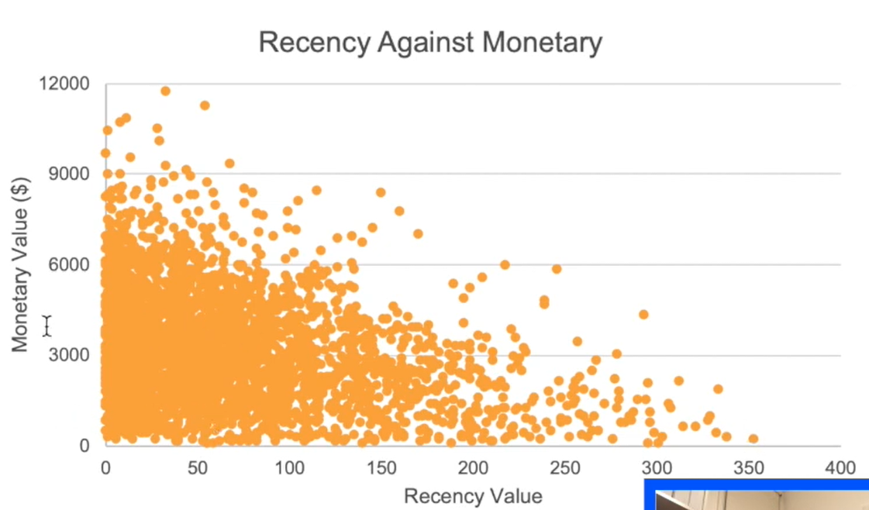
Note: The data and information in this document is reflective of a hypothetical situation and client. This document is to be used for KPMG Virtual Internship purposes only.
Model Development
Scatter-Plot based off RFM Analysis
Very low frequency of 0-2 correlated with high recency values. ie; More than 250 days ago
Customers that have visited more recently (0-50 days) have a higher chance of visiting more frequently (6+)
Higher frequency has a negative relationship with recency values. Such that very recent customers are also frequent customers.

Slide 17
Note: The data and information in this document is reflective of a hypothetical situation and client. This document is to be used for KPMG Virtual Internship purposes only.
Interpretation
Customer Title Definition list With RFM Values Assigned
Rank | Customer Title | Description | RFM Value
1 | Platinum Customer | Most recent buy, buy often, most spent | 444
2 | Very loyal | Most recent, buys often, spends large amount of money | 433
3 | Becoming loyal | Relatively recent, bought more than once, spends large | 421
4 | Recent customer | Bought recently, not very often, average money spent | 344
5 | Potential customer | Bought recently, never bought before, spent small amount | 323
6 | Late bloomer | No purchases recently, but RFM value is larger than average | 311
7 | Losing customer | Purchases was a while ago, below average RFM value | 224
8 | High Risk customer | Purchase was long time ago, frequency is quite high, amount spent is high | 212
9 | Almost lost customer | Very low recency, low frequency, but high amount spent | 124
10 | Evasive customer | Very low recency, very low frequency, small amount spend | 112
11 | Lost customer | Very Low RFM | 111

Slide 18
Note: The data and information in this document is reflective of a hypothetical situation and client. This document is to be used for KPMG Virtual Internship purposes only.
Interpretation
Customer Target and Methodology
Rank | Customer Title | Description | Number of customers | Cumulative | Customer Selection
1 | Platinum Customer | Most recent buy, buys often, most spent | 176 | 176 | 176
2 | Very loyal | Most recent, buys often, spends large amount of money | 184 | 360 | 184
3 | Becoming loyal | Relatively recent, bought more than once, spends large amount of money | 344 | 704 | 344
4 | Recent customer | Bought recently, not very often, average money spent | 368 | 1072 | 296
Filter through the top 1000 customers by assigning the conditions discussed in the table above
The 1000 customers discovered would have bought recently, they have bought very frequently in the past and tend to spend more than other customers.

Slide 19
Note: The data and information in this document is reflective of a hypothetical situation and client. This document is to be used for KPMG Virtual Internship purposes only.
Appendix

Slide 20
Note: The data and information in this document is reflective of a hypothetical situation and client. This document is to be used for KPMG Virtual Internship purposes only.
Appendix
This is an optional slide where you may place any supporting items.

Slide 21
Note: The data and information in this document is reflective of a hypothetical situation and client. This document is to be used for KPMG Virtual Internship purposes only.
Thank You
Any Questions?

